Slide 1

Sales Data Analysis and Marketing Strategies
By Carlos Campos

Slide 2
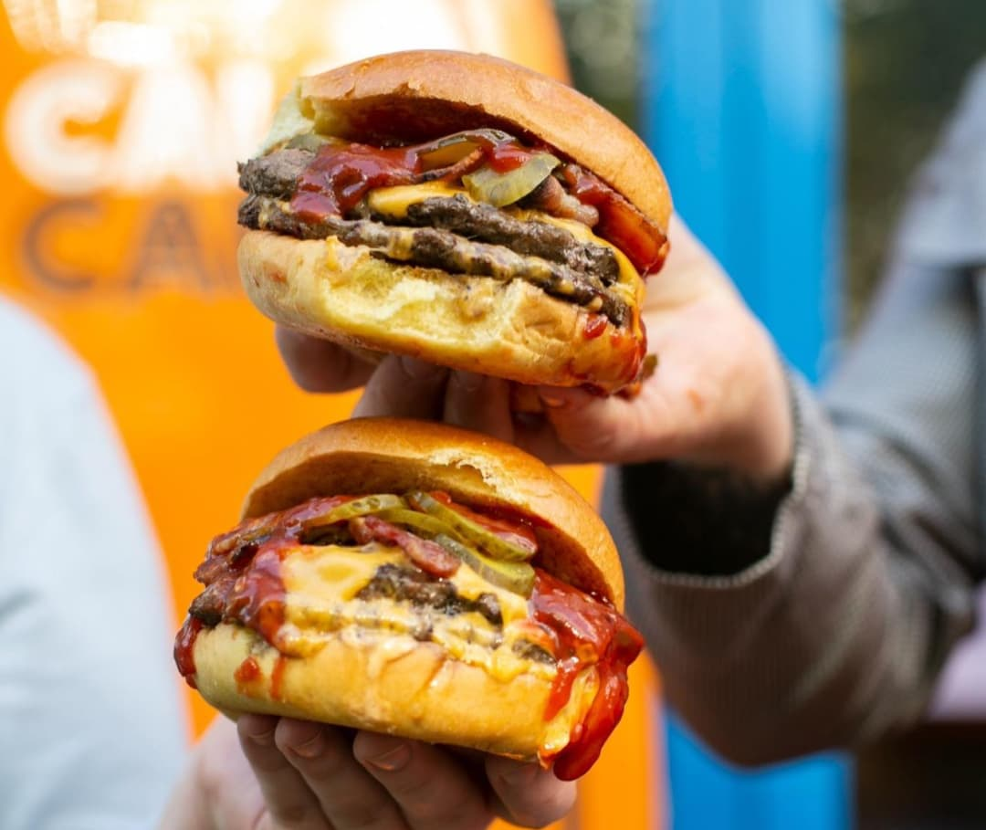
Overview
Goals
Sales Data Analysis
Marketing Strategies
Conclusion

Slide 3
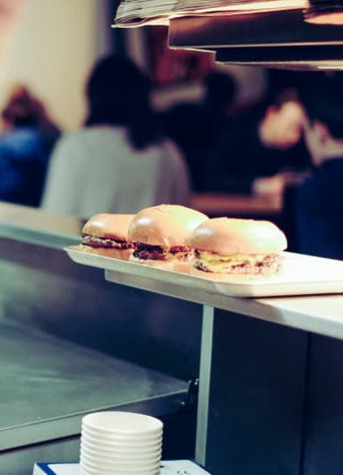
Goals
Unfold Insights found in Sales Data
Propose Marketing Strategies based on the Data
Set fundaments for more elaborated Strategies
Elaborate how can “Friends of Bujo” App Data and other Data could help with Business and Marketing Objectives

Slide 4
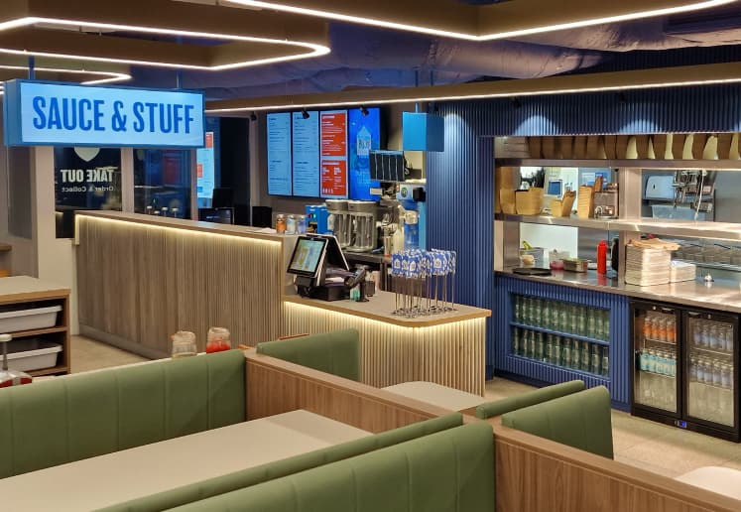
Sales Data Analysis Insights
Terenure Sales are the lowest. Yeah we know that already. But How Low? And what can we do about that?
Lets check out the Data…

Slide 5


Sales Data Analysis Insights
On Tuesdays we have the lowest sales: Apply a special promotion on Tuesday and/or Monday to increase sales in death days. Additionally Implement “Happy Hour” for death hours other days.

Slide 6

Sales Data Analysis Insights
TereBuJo
in
Terenure !
In July and August we have the lowest Sales: Apply a promotion these months to uplift sales these months especially in august in Terenure.
Idea Example: “TereBujo” month in Terenure

Slide 7
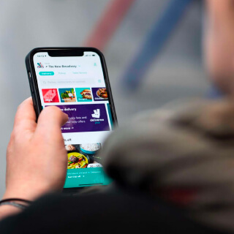
Sales Data Analysis Insights
January and November of 2024, Deliveroo sales surpassed in store sales.
Sales of Deliveroo sometimes even reaches to credit card sales which are made on store in Terenure: Consider strategies for loyal Deliveroo costumers too as there must be many in the app. Not only for Terenure also for Sandymount too.

Slide 8
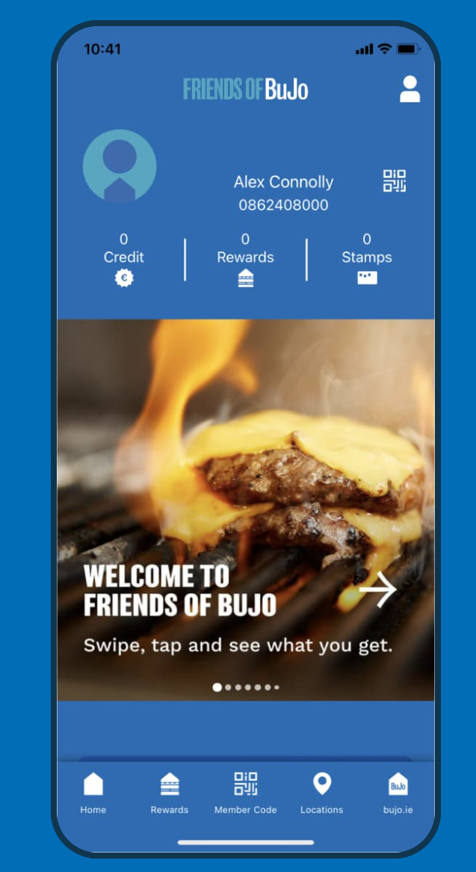
Sales Data Analysis Insights
In Terenure Tips are correlated to sales as this means that customer are satisfied with the attention they are given since the tips system was implemented.
In April of 2024 the highest amount of discount was given after that it reduced and stagnated. Our best costumer should be awarded with discounts and benefits

Slide 9
Marketing Strategies
Idea 1: Apply a Digital marketing campaign for new burgers and the New location (Refer to Digital Marketing Proposal)
Idea 2: Have a closer relationship in the Terenure Community
Idea 3: Create Ghost Kitchen Restaurant in Terenure that could help aid the revenue of that location.

Slide 10
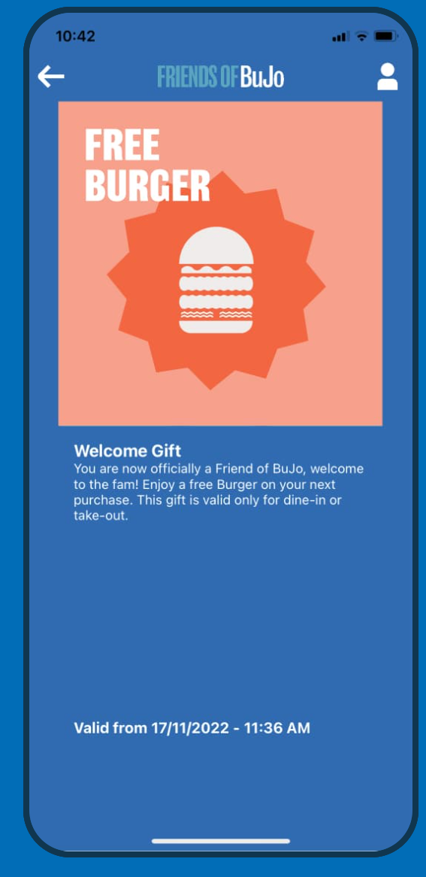
What ‘Friends of Bujo’ Data can Help?
Identity Data: Address, Birthday,Phone number, e mail
Transactional Data: what customers buy, how often they buy it, and how much they spend
Order Data: order date and time, frequency, items purchased, dietary restrictions and allergies at the individual level
Engagement Data: Number of points earned, rewards redeemed, and participation in challenges or promotions. Usage Patterns.
Demographic and Psychographic Data: Demographic information, especially their location, and potentially their age, gender, and income level.

Slide 11
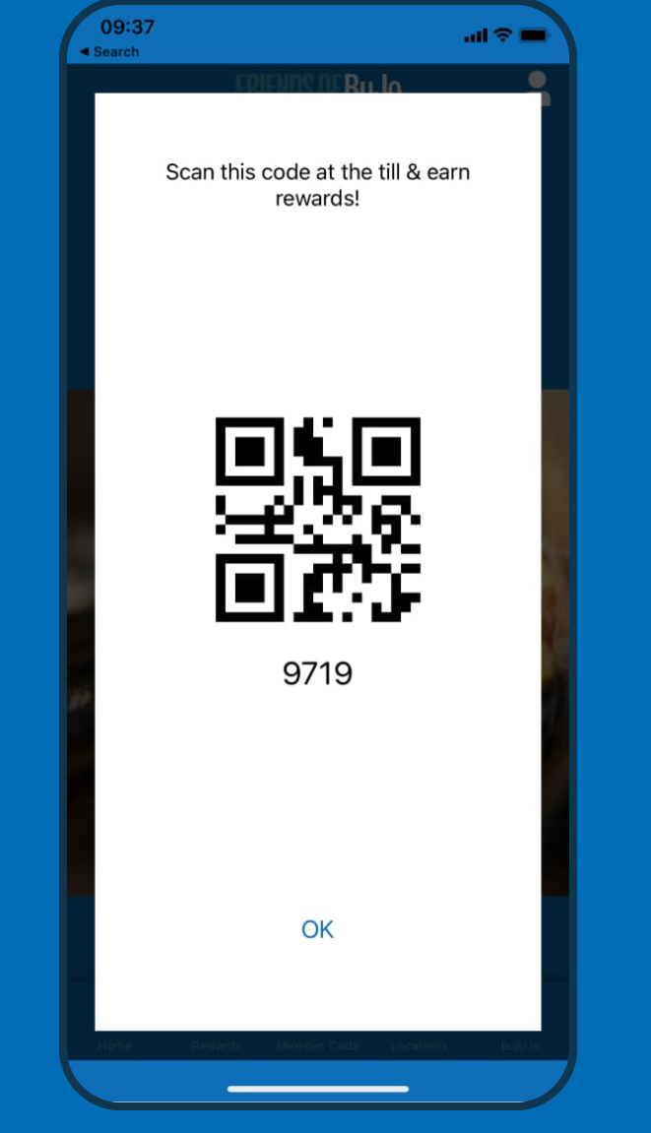
How can ‘Friends of Bujo’ Data Help?
Identity Data: Track specific customer activity and ensure accurate data association
Transactional Data: Reveal insights into individual preferences and spending Habits. Reinforce with Loyalty program and Rewards.
Order Data: Understand patterns in customers’ ordering habits, to deliver more targeted and well-timed offers through the loyalty program.
Engagement Data: Measures program effectiveness and identifies areas for improvement.
Demographic and Psychographic Data: View customers’ lifestyles, interests, values, and attitudes.

Slide 12
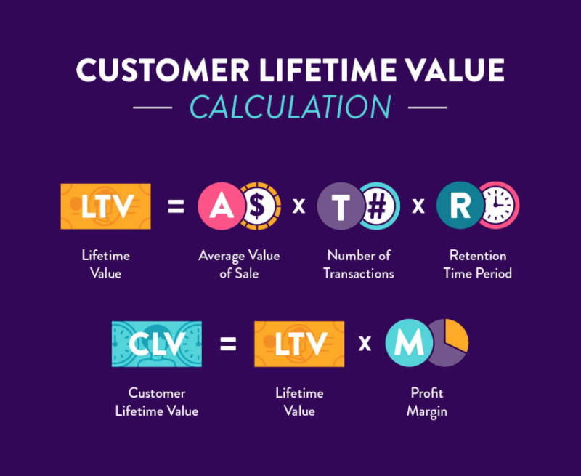
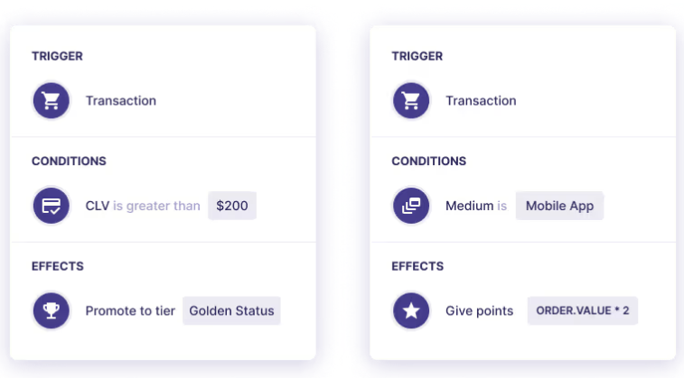
CLV is an important Data to know
Notes:
CLV is a metric that predicts the total monetary value a customer is expected to generate for a company over the entire duration of their relationship. It goes beyond individual transactions, considering the entire customer relationship to help businesses make informed decisions about marketing, resource allocation, and strategies to improve customer loyalty and retention

Slide 13
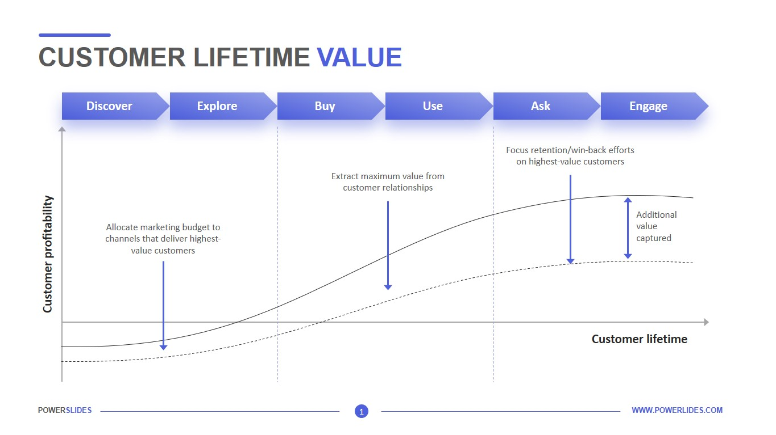
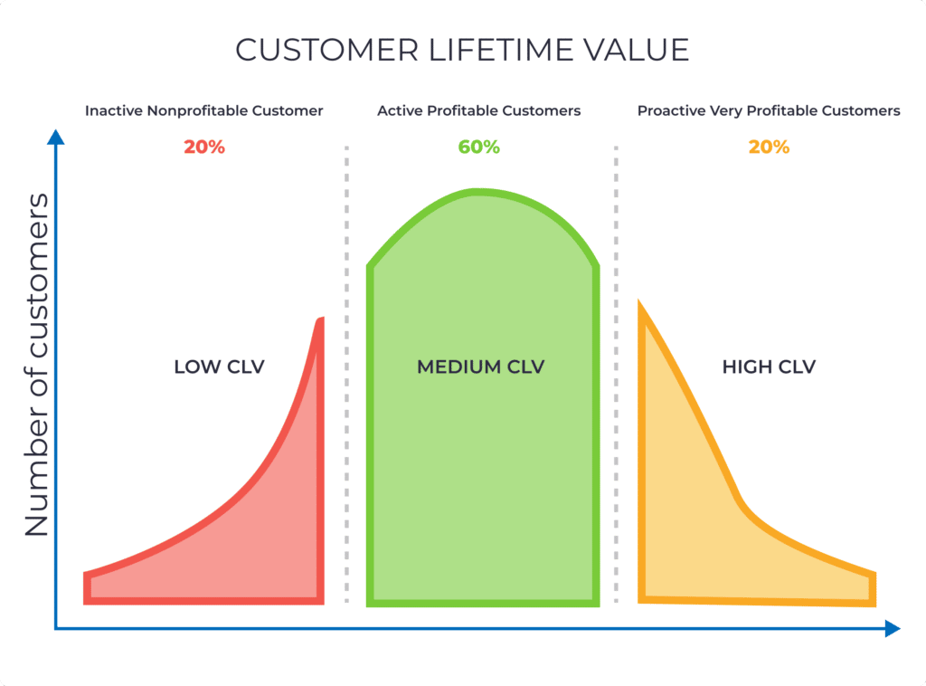
CLV is an important Data to know

Slide 14
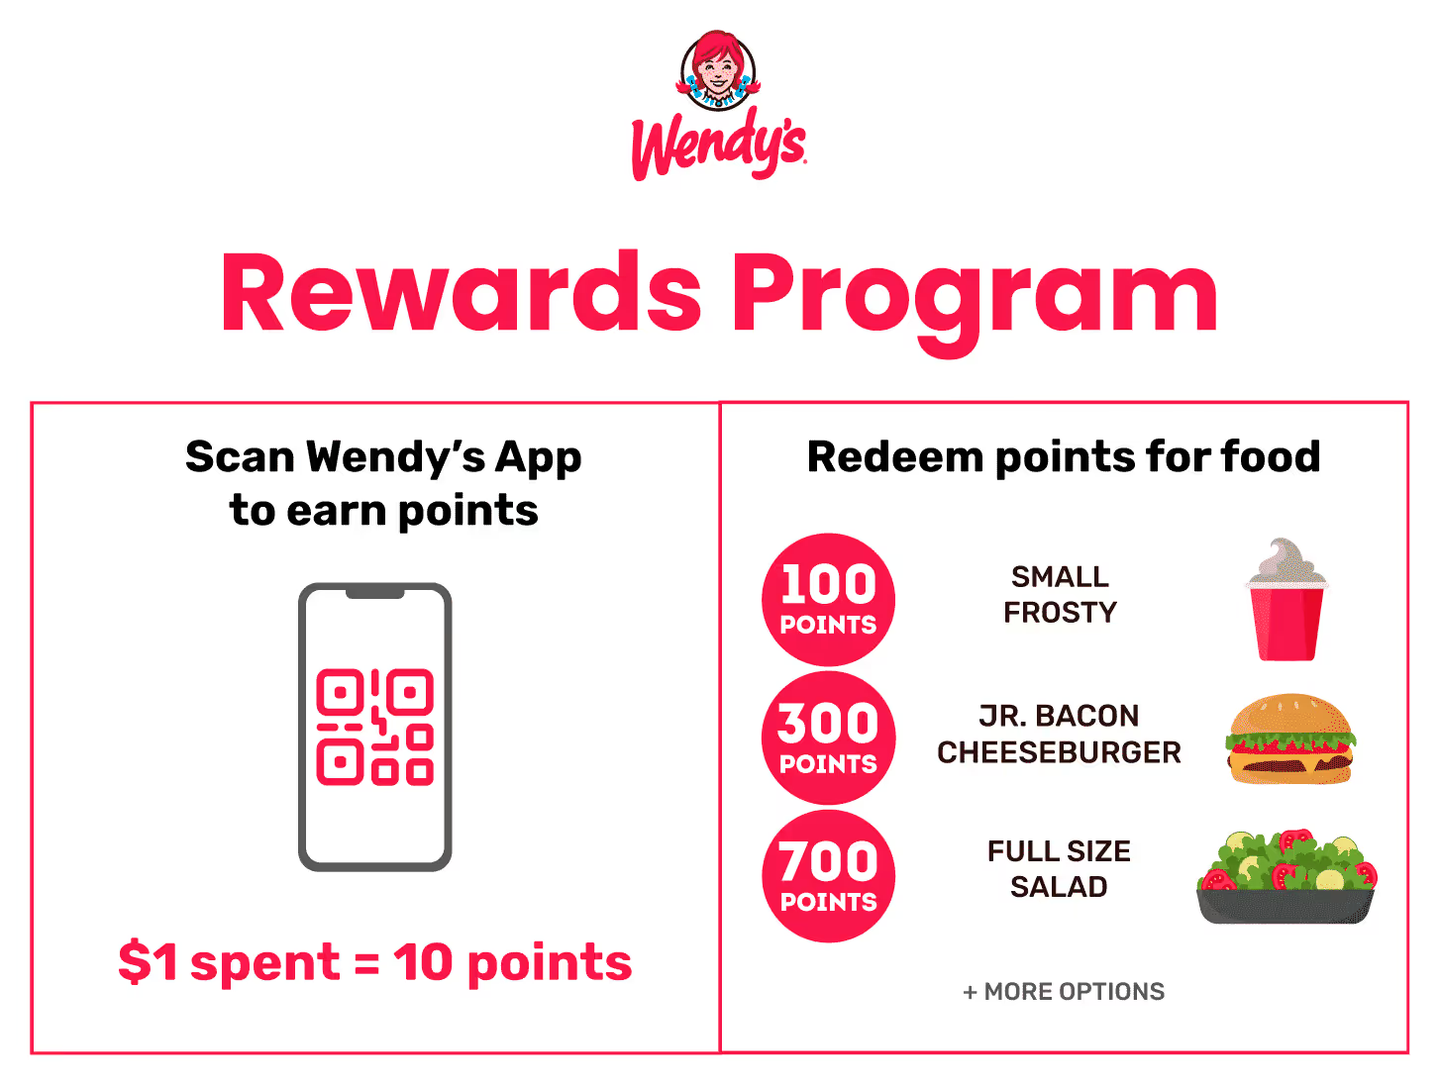
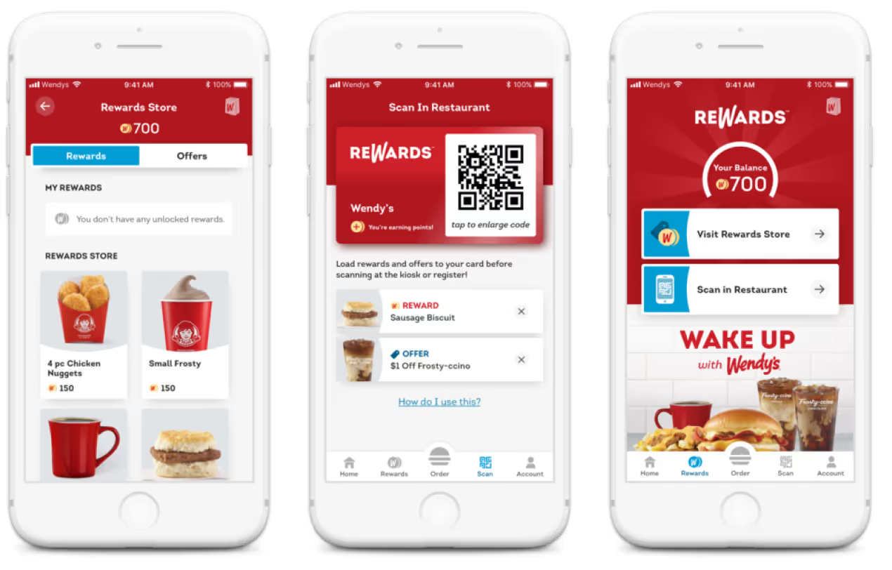
Simplifly Rewards Program

